Slide 1
Chapter 24
Industry Comes of Age, 1865-1900

Slide 2
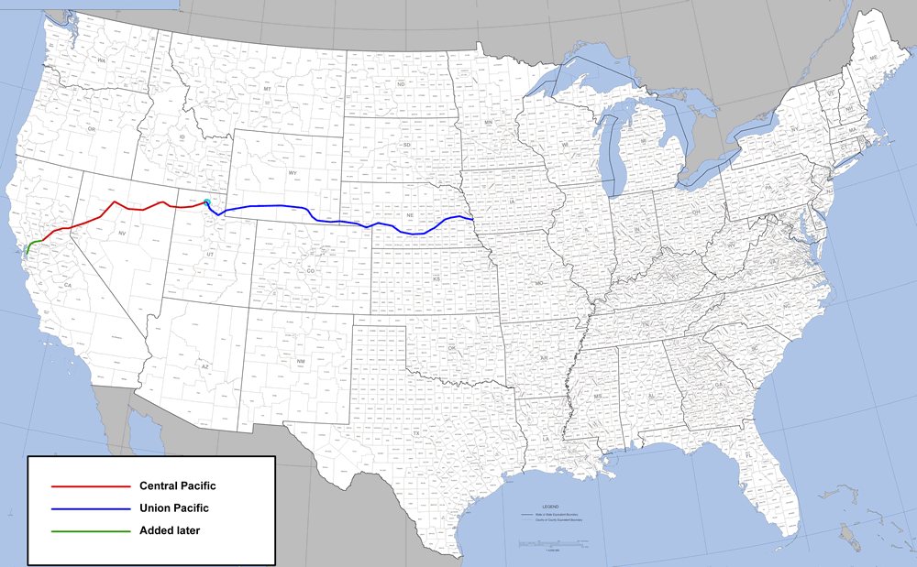
Transcontinental Railroads
Union Pacific RR -> built west from Omaha, NE
Given 20 square miles of land for each mile of track laid
Alternating 640-acre sections on either side of track
Given generous loans from government
$16K/per mile on flat prairie land (1,086 miles total)
“Irish Paddies”
Central Pacific RR -> Sacramento to Sierra Nevada
Given same subsidies as Union Pacific
$48K/mile in mountain country (689 miles)
Used predominantly Chinese labor
Great Northern:
Connected Minnesota to Seattle

Slide 3
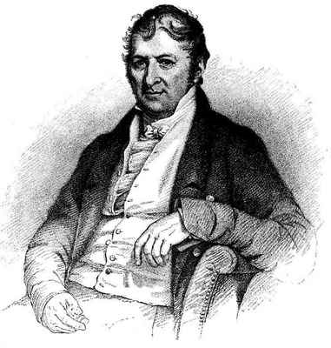
Railroad Consolidation and Mechanization
Cornelius Vanderbilt:
Made millions in RR industry, popularized the steel rail
Two improvements in RR:
Steel rail -> safer, stronger, last longer
Standard gauge of track -> think interchangeable parts, popularized by??????
Other advancements:
Westinghouse air brake
Pullman Palace Cars

Slide 4
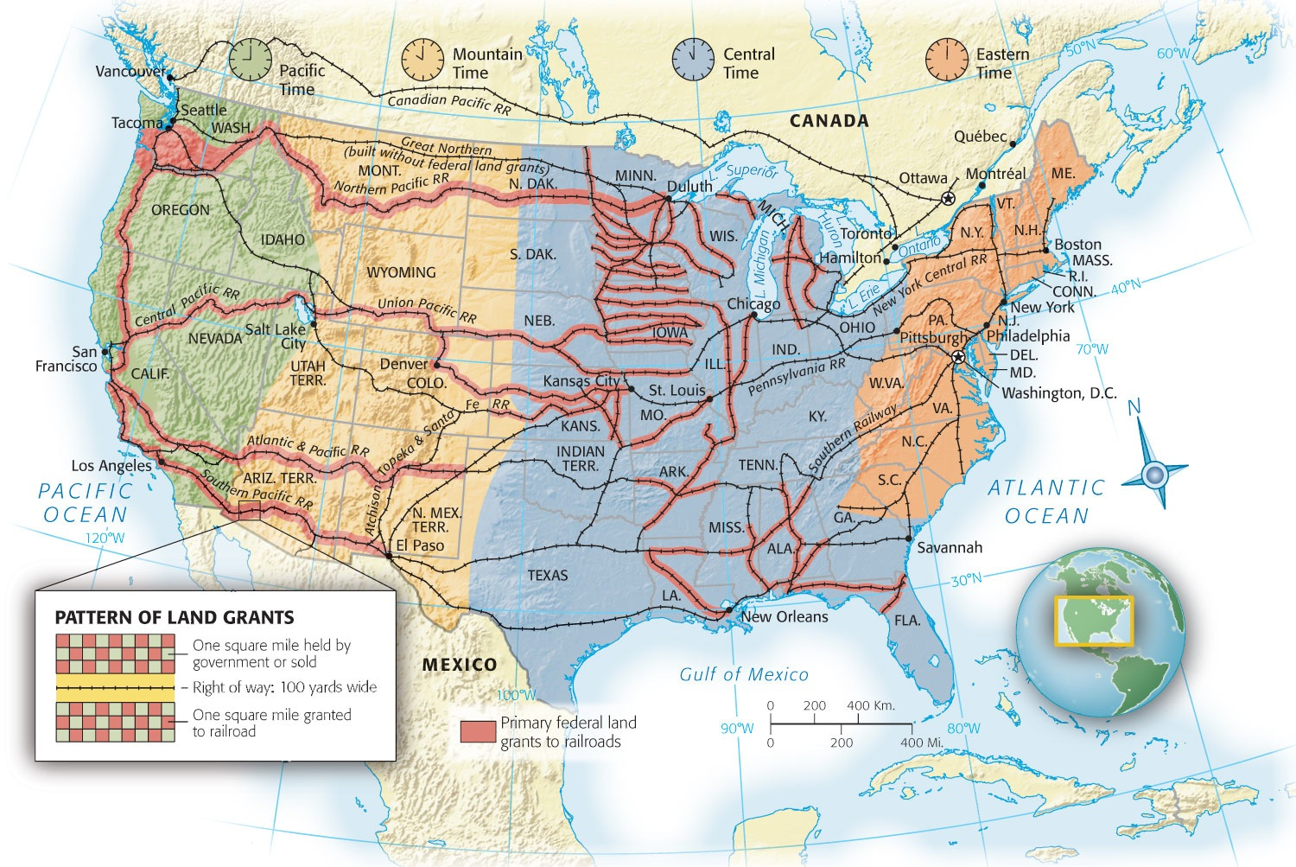
Revolution by Railways
RRs created an enormous domestic market for American raw materials and manufactured goods
Other impacts of RR:
Stimulated immigration
Establishment of time zones

Slide 5
Wrongdoing in Railroading
Stock watering: Railroad stock promoters grossly inflated value of stock.
RR tycoons became very powerful
Bribed judges and legislatures, employed lobbyists, etc.
“Pools”
An agreement to divide the business in a given area and share the profits
Charged more for short hauls than long ones

Slide 6
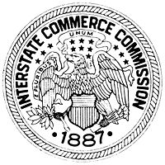
Government Bridles the Iron Horse
Should government intervene? Goes against laissez-faire philosophy (Grover Cleveland)
Farmers wanted to regulate RRs via state legislatures
Wabash case:
Individual states had no power to regulate interstate commerce
Haven’t we seen this before?
Gibbons v. Ogden (1819)
Interstate Commerce Commission (ICC)
Prohibited rebates and pools
First large-scale legislation passed by federal government to regulate corporations in the interest of society
ICC didn’t effectively regulate the railroads; way to appease the public

Slide 7
New Inventions
Millionaires look for areas to invest their capital
Patents were issued at high rates
Key inventions:
Phone (Alexander Bell); leads to women working the “switchboard”
Electric light, phonograph, mimeograph, Dictaphone, moving pictures.

Slide 8
**Integrations**
Andrew Carnegie (steel, Pittsburgh)
vertical integration:
Controlling every aspect of production from beginning to end
Iron ore to Bessemer process
improve efficiency by making supplies more reliable, controlling quality of the product at all stages of production, and eliminate middlemen’s fees
legal
Horizontal integration: (Rockefeller)
Owning most or all businesses in an industry
“Let us prey.”
Illegal

Slide 9
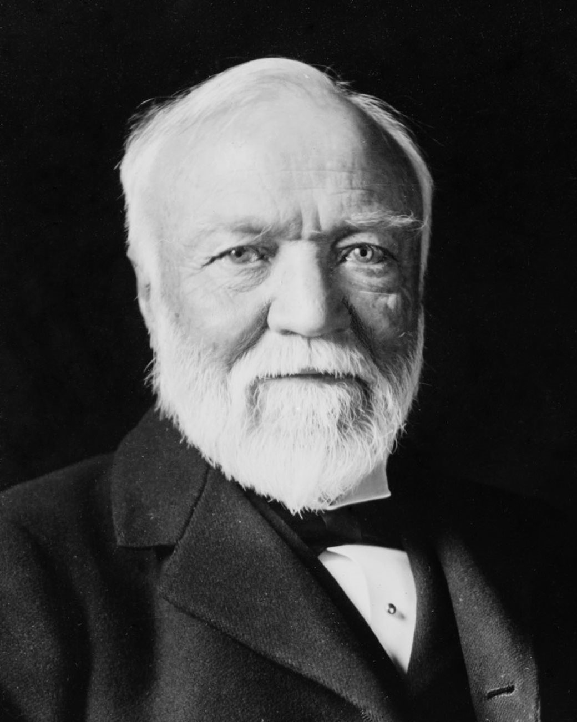
The Gospel of Wealth
Carnegie believed the wealthy should be “morally responsible”
“Survival of the fittest” (Spencer, H.)
Darwin's ideas about species were later applied to businesses and humans
Since Congress controlled INTERstate trade, monopolists hid behind 14th Amendment
Corporations viewed as a “person”
“Due process”

Slide 10
Sherman Antitrust Act
Sherman Antitrust Act (1890)
Created in response to public demand for curbing excesses of trusts.
**Provision**: Forbade combinations in restraint of trade (break up monopolies and trusts)
Largely ineffective as it had no significant enforcement mechanism.
***Ironically, used by corporations to curb labor unions or labor combinations that were deemed to be restraining trade. ***

Slide 11
**Impact of the IR on America**
Standard of living rose sharply and remained highest in the world
Urbanization developed as a result of factories
The work-place became regimented and impersonal
Women achieved social and economic independence in new careers as typing, stenography, and switchboard operating
Marriages delayed, smaller families resulted

Slide 12
Unions
A group of workers in the same industry that come together
Massive Immigration created a favorable labor market for owners
Business advantages against unions:
Could import strike breakers (scabs)
Courts could order strikes to end
(Hayes used military)
Presidents side with business (except Teddy Roosevelt)
“yellow-dog contracts”
“Black list”

Slide 13
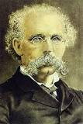
Labor Unions
National Labor Union:
Major boost to union movement
Lasted 6 years, 600,000 workers
Excluded Chinese, barely included women and Blacks
Knights of Labor: Led by Terence Powderly
Much of leadership and membership was Irish
Sought to include all workers in "one big union" including Blacks & women
Wanted 8 hour work day
***Skilled and unskilled workers***

Slide 14
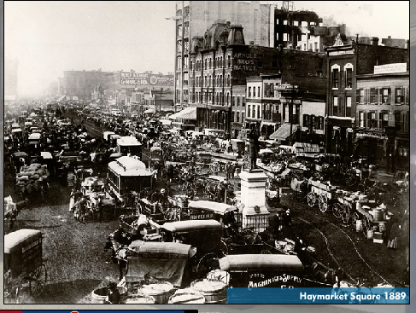
Downfall of the Knights of Labor
Demise due to Great Upheaval (1886) – 1,400 strikes involving 500,000 workers and Haymarket Square bombing:
Alleged German anarchists urged violent overthrow of gov't
A dynamite bomb thrown in the crowd that killed or injured dozens
**Knights were associated with anarchists**

Slide 15
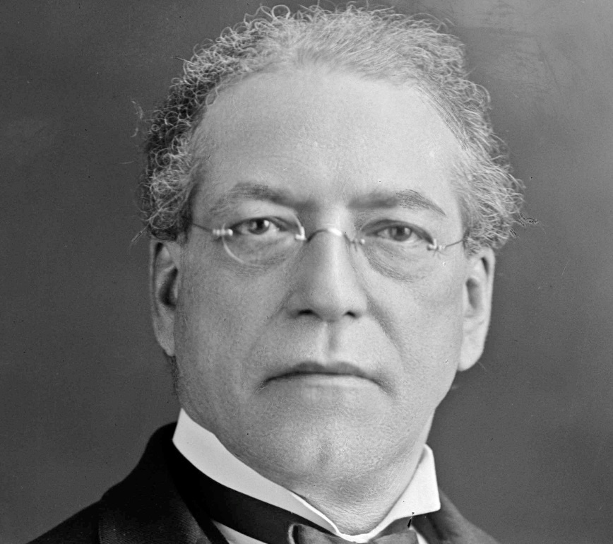
The AF of L to the Fore
Formed in 1886 under the leadership of Samuel Gompers
***Shunned politics for economic strategies and goals – “bread and butter” issues***
Only consisted of skilled workers
Consisted of an association of self-governing national unions with the AFL unifying overall strategy.
Chief weapons were walkout and boycott

Slide 16
That’s it!
Visit APUSHReview.com
Help spread the word!
Questions? Comments? Ideas for class?
Email or leave in comments
Like my mustache? Hate my mustache?

